Slide 1

ui
git
api
llm
auth
db
RepoScope
See your repo. Understand it. Track it.
v3.0 — from understanding to building
Built with IBM Bob + Z Code · lablab.ai · Devpost
01
Notes:
Welcome to RepoScope. If you have ever joined a new codebase, you know the drill: understanding a new repo used to mean five browser tabs — the file tree in one, a pull request in another, search in a third, and docs you never quite trust. RepoScope collapses all of that into one workspace built on a single knowledge graph: every file, import, commit, and dependency becomes a node you can see, query, and tour. Today we are shipping version 3.0, which adds five new build-on-top features that take you from understanding a repository to actually building on it. And every part of this project — backend, frontend, and docs — was built with IBM Bob and Z Code.

Slide 2
Built with IBM Bob + Z Code.
SESSION LOG
S1
Backend core
FastAPI server · graph_builder · GitHub client · SSE streaming
ibm bob · session 3
> bob: add a security scan endpoint
S2
Frontend workspace
created routes/security.py
React + React Flow graph UI · chat panel · code tours
wrote 3 regex detectors
tests green ✓
session exported → docs/bob-sessions/s3.md
github.com/<your-handle>/reposcope/tree/main/docs/bob-sessions
S3
v3.0 features
PR bot · student mode · voice tours · security scan · scaffold
IBM Bob
Z Code
pair-programmed end to end
02
Notes:
This slide is our proof of how the product was built. Bob designed the overall architecture and then wrote the code across three sessions — backend, frontend, and docs. Session one covered the backend core: the FastAPI server, graph_builder, the GitHub client, and SSE streaming. Session two delivered the frontend workspace: the React app with the React Flow graph UI, the chat panel, and code tours. Session three shipped the v3.0 features — the PR bot, student mode, voice tours, the security scan, and scaffolding — and that is the session Z Code pair-programmed on. On the right you can see a real slice of that session: asking for a security scan endpoint and getting routes, detectors, and green tests back. Every session export is committed to the repo under docs/bob-sessions, so you can read the exact prompts and outputs yourself.

Slide 3
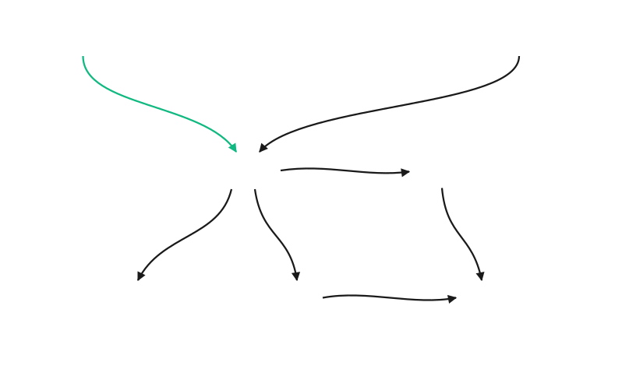
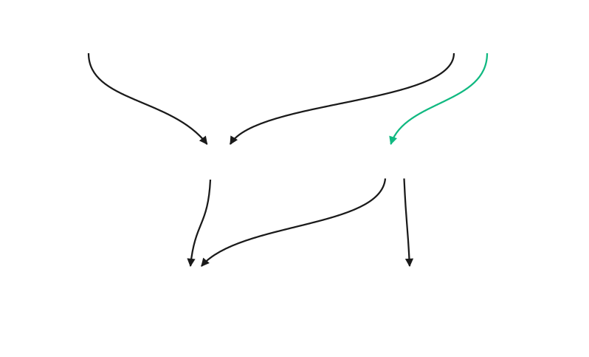
Demo repos.
two real repos — one knowledge graph each
Verdict
Python · FastAPI
StudyRot
student study app
github
ui
ui
state
api
auth
db
tour
db
llm
sse
quiz
tts
Architecture graph + impact analysis demo
Code tours + voice narration demo
Scaffold example — backend/main.py starter kit
Student Onboarding Mode — Row 0–5 path
both repos scanned live in the demo video
03
Notes:
We demo on two real repositories, not toy samples. On the left is Verdict, a Python FastAPI backend — its graph shows the GitHub connector pulling the repo tree, the API layer, auth, the database, the LLM service, and the SSE stream. Verdict powers the architecture graph and impact analysis demo, and it is also the target for the scaffold example, which generates a backend/main.py starter kit from the live graph. On the right is StudyRot, the student-facing app — UI, state, database, tours, quizzes, and text-to-speech — which is what we use to demo code tours with voice narration and the Student Onboarding Mode with its Row 0–5 path. The key point: both thumbnails are real output of the exact same graph engine, just pointed at two different repositories, and both repos are scanned live in the demo video.

Slide 4



Live right now.
ALL SYSTEMS LIVE
Live app
API health
Demo video
repo-scope-nu.vercel.app
reposope.onrender.com/api/health
youtu.be/W82roIETJJ8
deployed · Vercel
deployed · Render · 200 OK
3-minute walkthrough
Paste any public GitHub URL — the graph renders in seconds. Try it during Q&A.
04
Notes:
Everything on this slide is live right now, not a promise. The app itself is deployed on Vercel at repo-scope-nu.vercel.app. The API health endpoint is deployed on Render at reposope.onrender.com/api/health, and it is returning 200 OK as we speak — you can hit it yourself. And there is a three-minute walkthrough video at youtu.be/ZJ7PMCZRXKY if you want to see the full flow again later. Here is the part I would encourage most: judges can paste any public GitHub URL into the app during Q&A — any repository you actually care about — and the knowledge graph renders in seconds. No signup, no setup, no waiting. We built RepoScope to be tried live, and we are happy to be tested on your own code during the question round.

Slide 5
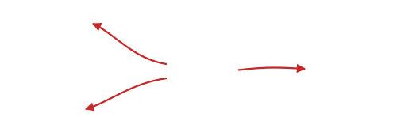
Core features.
01
02
03
ui
api
how does auth work?
1
2
3
4
services
JWT sessions —
services/auth.py:42
main
auth
routes
tests
data
Architecture Graph
Q&A with citations
Code Tours
Layered map of the whole repo — client to compute.
Answers cite files, functions, and commits.
Guided walkthroughs of any module.
04
05
06
routes
commit a1b2c3
# rebuild prompt
auth
ui
PR #42 merged
FastAPI backend, 3 services…
issue #17 closed
agent — rebuild this repo.
tests
Impact Analysis
Tracking
Reverse Prompt
Change a function — see the blast radius.
Commits, PRs, issues, releases — on demand.
Any repo → an agent-ready rebuild prompt.
05
Notes:
These are the six day-one features. The architecture graph gives you a layered map of the whole repository, from the client down to compute. Q&A lets you ask questions in plain language, and every answer cites the exact files, functions, and commits it came from — like services/auth.py line 42. Code tours guide you through any module stop by stop. Impact analysis shows the blast radius before you change a single function. Tracking pulls commits, pull requests, issues, and releases on demand. And reverse prompt turns any repo into an agent-ready rebuild prompt. The key point: all six features are views over the same knowledge graph — one graph, many lenses. Version 3.0 adds five more features on top of this foundation, and that is what is coming up next.

Slide 6
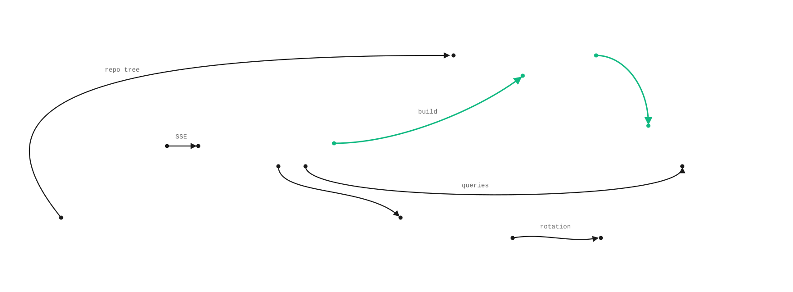
Architecture.
how a GitHub URL becomes a living knowledge graph
graph_builder
AST walk · files, imports
React UI
FastAPI
Knowledge Graph
React Flow · SSE client
Python 3.11 · REST + SSE
nodes · edges · layers
GitHub REST API
key_rotator
Groq / NIM
tree · commits · PRs
Groq ⇄ NIM failover
OpenAI-compatible LLM
graph_builder — one pass per repo, AST to edges
key_rotator — Groq primary, NIM fallback
every feature is a query on the same graph
06
Notes:
Here is the whole system in one picture. On the left, the React UI — React Flow renders the knowledge graph client-side, with updates streaming in over SSE. FastAPI in the middle is the orchestrator: you hand it a GitHub URL, it pulls the repo tree, commits, and pull requests from the GitHub REST API, and hands that tree to graph_builder, which turns the GitHub tree into the knowledge graph in a single pass — an AST walk that extracts files and imports as nodes and edges. Every feature you just saw is then just a query on that same graph. On the bottom, key_rotator manages our LLM keys, failing over from Groq to NVIDIA NIM automatically — that rotation is why the live demo never dies, even if one provider rate-limits us mid-presentation.

Slide 7





NEW IN 3.0
5 features · 1 graph
From Understanding to Building.
v2 read your repo. v3.0 helps you ship to it.
01
02
03
04
05
HERO
PR Bot
Student Onboarding
Voice Tours
Security Scan
Scaffold
impact review on every PR
guided path to a first PR
narrated graph walkthroughs
secrets · CVEs · breaking bumps
repo → starter kit in 5 sec
each feature → one deep-dive slide next
07
Notes:
This slide is the turn. Version 2 of RepoScope was about understanding — the graph, the chat, the impact panel. Version 3.0 is about building on top of what you understand. Five features ship today: the PR Bot, which drops an impact review on every pull request; Student Onboarding Mode, which guides a newcomer down a path to their first PR; Voice Code Tours, narrated walkthroughs of the dependency graph; the Security Scan, flagging secrets, CVEs, and breaking dependency bumps; and Scaffold, the hero — any repo into a starter kit in five seconds. Each feature gets one deep-dive slide next, and every one of them is demoed live in the video.

Slide 8
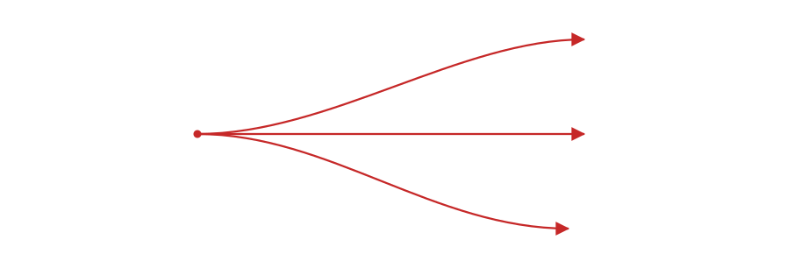
NEW IN 3.0 · FEATURE 01 / 05
PR Bot.
impact review lands on every pull request
RS
POST /api/impact/pr
RepoScope-Bot
BOT
commented · now
one endpoint — fired automatically on every opened PR
Impact analysis for this PR
RISK SCORE
72
/ 100
MODERATE
Reuses impact_analyzer
IMPACTED FILES
the exact engine behind the in-app impact panel — zero duplicated logic
services/auth.py
+12 −4
routes/api.py
+8 −2
tests/test_auth.py
+21 −0
.github/workflows/pr-impact.yml
impact.png
blast radius
a GitHub Action workflow — install, comment, done
routes/api.py
impacted
Impact panel preview button
services/auth.py
tests/test_auth.py
one click from the comment jumps into the full interactive panel
changed
impacted
db/session.py
impacted
IMPACT
Prevents breaking changes in CI.
08
Notes:
Feature one: the PR Bot. The key point — it reuses the exact same impact_analyzer engine that powers the in-app impact panel, so there is zero duplicated logic and the risk numbers always agree between bot and app. It ships as one GitHub Action: drop .github/workflows/pr-impact.yml into the repo, and on every opened pull request the workflow calls POST /api/impact/pr. Seconds later the RepoScope-Bot comment lands in the thread — a risk score of 72 out of 100, moderate in this case, the per-file diff stats, and a blast-radius PNG showing exactly which files the change touches. All of that arrives before a human ever reviews the PR, and one click on the preview button in the comment jumps straight into the full interactive impact panel.

Slide 9
NEW IN 3.0 · FEATURE 02 / 05
Student Onboarding Mode.
from lost → first pull request
Graph ranking — incoming × 2 + outgoing
StudyRot · workspace
Student Mode
every file lands on a difficulty row from 0 to 5
GRAPH RANKING
rank = incoming × 2 + outgoing
Row 4–5 = Good First Issues
Row 0
Row 1
Row 2
Row 3
Row 4
Row 5
gentle, well-scoped entry points surfaced automatically
← Good First Issues
LEVEL PATH
3 quizzes per level
Level 1 — Repo basics
quiz 3/3 ✓
understanding is verified before the path unlocks
Level 2 — Core modules
quiz 2/3
IMPACT
Level 3 — First contribution
locked
Onboarding: days → 20 minutes.
ML Empowerment · education track
09
Notes:
Feature two: Student Onboarding Mode — from lost to first pull request. The same dependency graph now produces a difficulty ranking: rank equals incoming edges times two plus outgoing, so every file lands on a row from zero to five. Rows four and five are the gentle, well-scoped entry points — those are surfaced automatically as Good First Issues. On top sits a three-level path: repo basics, core modules, and finally first contribution. Each level has three quizzes, and understanding is verified before the path unlocks — level three stays locked until level two is passed. The payoff is the impact line: onboarding that used to take days drops to about twenty minutes. This feature was built for the ML Empowerment education track.

Slide 10
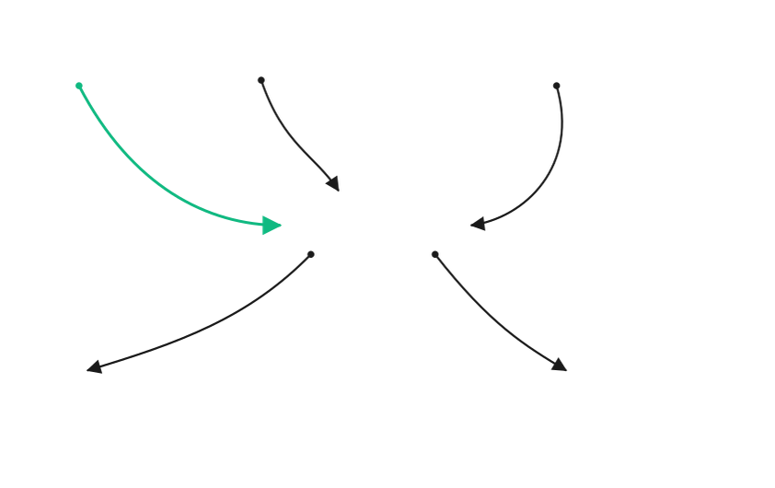
NEW IN 3.0 · FEATURE 03 / 05
Voice Code Tours.
the repo that talks back
Web Speech API · speechSynthesis
Play Tour
narration: browser TTS
built into every modern browser — zero cost, zero cloud calls
NOW PLAYING
Stop 2 / 6 — services/auth.py
Auto-pan sync
the graph camera follows the narration stop by stop
main.py
sse.py
routes/api.py
Accessibility first
auto-pan →
blind and low-vision students can explore a repo by ear
services/auth.py
stop 2
Clones the Aster winner
the voice-tour experience judges already awarded — now on any repo
llm/groq.py
db/models.py
IMPACT
A repo tour you can take with your eyes closed.
10
Notes:
Feature three: Voice Code Tours — the repo that talks back. Narration runs on the Web Speech API, speechSynthesis, which is native to every modern browser: zero cost, zero cloud calls, no API keys to manage. As the narration moves stop by stop, the graph camera auto-pans in sync — on the mock you can see stop two of six, services/auth.py, wrapped by the panning camera frame. The primary goal is accessibility: blind and low-vision students can explore an entire repository by ear, something code editors have never really offered. And there is pedigree here — this clones the voice-tour experience that judges already awarded at Aster, and puts it on any repo.

Slide 11
NEW IN 3.0 · FEATURE 04 / 05
Security Scan.
three flags. zero surprises in production
Graph
Chat
Tours
Security
Settings
POST /api/security/scan
one endpoint returns the full flag list
Run scan
3 findings
API-key regex detection
sk-, ghp_, AKIA… patterns flagged on sight
BREAKING
pin or migrate
pydantic 1.10 → 2.0 · major bump
.env leak detection
secrets committed to git history are caught
SECRET
rotate key
API key regex · services/llm.py:42
Major bump = BREAKING
dependency major-version jumps flagged red before CI does
CVE
upgrade
Nord Security track
requests 2.28.0 · known advisory
IMPACT
Catch it in the tab — not in the incident channel.
11
Notes:
Feature four: Security Scan — three flags, zero surprises in production. One endpoint, POST /api/security/scan, returns the entire flag list. The flags are color-coded: red BREAKING for dependency major-version jumps, like pydantic 1.10 to 2.0; amber SECRET for leaked keys, caught by regex patterns such as sk-, ghp_, and AKIA — here a key sitting at services/llm.py line 42; and orange CVE for packages with known advisories, like requests 2.28.0. Beyond regex-based key detection, it also checks for .env files leaked into git history. Each finding comes with an action hint — pin or migrate, rotate the key, upgrade. It was built with the Nord Security track in mind: you catch it in the tab, not in the incident channel.

Slide 12
HERO
NEW IN 3.0 · FEATURE 05 / 05
Scaffold.
From Repo to Starter Kit in 5 Sec
CodeCrafters-style starter kits
BEFORE — REVERSE PROMPT
AFTER — SCAFFOLD MODAL
Scaffold — verdict
backend/
1
from fastapi import FastAPI
main.py
2
app = FastAPI()
3
@app.post("/predict")
requirements.txt
4
def predict():
5
# TODO: implement predict
README.md
# Reverse Build Prompt — verdict
5 sec
Rebuild this repo: FastAPI backend,
3 services, Postgres store, SSE streaming.
You are an agent — rebuild it.
Download ZIP
Open in StackBlitz
verdict → starter kit
text a human still has to interpret
12
Notes:
And the hero feature: Scaffold — from repo to starter kit in five seconds. The reverse prompt was powerful, but it was still text a human had to interpret. Scaffold turns that same analysis into a downloadable starter kit: for the Verdict example it generates backend/main.py with real FastAPI boilerplate, requirements.txt, and a README, and marks the unfinished parts with TODO comments so you know exactly what to implement next. From the modal you can download the ZIP directly, or click Open in StackBlitz and start coding in the browser immediately. That is CodeCrafters-style onboarding applied to any repository — the same flow that takes a curious visitor and turns them into a contributor.

Slide 13
Tested. All green.
every command below ran against the deployed build
reposcope — zsh
pytest
green
$
pytest
✓
all tests passed
$
npm run build
curl
green
✓
build complete — 0 errors
$
curl reposope.onrender.com/api/health
{ "status": "
ok
" }
npm run build
green
$
curl -I repo-scope-nu.vercel.app
HTTP/2 200
$
/api/health
green
UI CLICKS
All 5 features tested via UI clicks
PR Bot
Student Mode
Voice Tours
Security Scan
Scaffold
13
Notes:
Let's talk proof. Everything in this terminal ran against the deployed build — not localhost. The pytest suite covers the backend end to end, and all tests passed. The production npm build completes with zero errors. On the deployment side, we curl the live services: the health endpoint on Render — reposope.onrender.com/api/health — returns status ok, and the Vercel app — repo-scope-nu.vercel.app — answers HTTP/2 200. So the pytest suite, both curl checks against the live Render API and the Vercel app, and the npm build are all green. Beyond the command line, all five v3.0 features — PR Bot, Student Mode, Voice Tours, Security Scan, and Scaffold — were additionally tested end to end by clicking through the real UI. Unit level, build level, deploy level, human level: all green.

Slide 14
Built for the judges.
two tracks, one live demo
ML EMPOWERMENT · education track
LOVHACK · automation track
Student Onboarding Mode
PR Bot
onboarding drops from days to 20 minutes
breaking changes blocked before CI
Voice Code Tours
Scaffold
accessible by design — blind students explore by ear
any repo → starter kit in 5 seconds
Quizzes + levels
Devtool wow
a real learning loop, not a dashboard
one graph under eleven features — the demo writes itself
LIVE DEMO FLOW
1 paste URL
→
2 graph renders
→
3 ask: how does auth work?
→
4 run security scan
→
5 scaffold in 5 sec
14
Notes:
We built for both judge tracks. For ML Empowerment, the education track, three features carry the impact: Student Onboarding Mode drops onboarding from days to twenty minutes; Voice Code Tours are accessible by design, so blind students can explore a repository by ear; and quizzes plus levels form a real learning loop, not a dashboard. For LovHack, the automation track: the PR Bot blocks breaking changes before CI ever runs; Scaffold turns any repo into a starter kit in five seconds; and one graph under eleven features delivers genuine devtool wow — the demo writes itself. Then we run the five-step live demo flow: paste a URL, the graph renders, ask "how does auth work?", run the security scan, and scaffold in five seconds. Two tracks, one live demo.

Slide 15
Tech stack.
FRONTEND
BACKEND
GRAPH ENGINE
React 18
TypeScript
Vite
Python 3.11
FastAPI
SSE streaming
graph_builder
impact_analyzer
Tailwind CSS
React Flow
pytest
knowledge graph
AST parsing
AI / LLM
INTEGRATIONS
DEPLOY
Groq — primary
NVIDIA NIM — fallback
GitHub REST API v3
GitHub Actions
Vercel — app
Render — API
key_rotator
OpenAI-compatible
Web Speech API
StackBlitz
MIT licensed
15
Notes:
A quick look under the hood. On the frontend, React Flow is what renders the interactive graph in the browser, inside a React 18, TypeScript, Vite and Tailwind CSS stack. On the backend, FastAPI serves it from Python 3.11 with SSE streaming, and pytest keeps it honest. The engine is our own graph_builder and impact_analyzer — AST parsing feeding a real knowledge graph. For the AI layer, Groq is the primary LLM with NVIDIA NIM as automatic fallback, both hidden behind our key_rotator over an OpenAI-compatible interface. Integrations cover the GitHub REST API v3, GitHub Actions, the Web Speech API for voice tours, and StackBlitz for scaffold output. And for deploy, Vercel hosts the app and Render hosts the API — all MIT licensed.

Slide 16
Open source. MIT.
fork it, ship it, extend it
LICENSE
MIT
MIT License
free to fork
Copyright (c) 2026 RepoScope contributors
free to ship
Permission is hereby granted, free of charge,
free to extend
to any person obtaining a copy of this software…
…use, copy, modify, merge, publish, distribute,
github.com/<your-handle>/reposcope/blob/main/LICENSE
sublicense, and/or sell copies…
16
Notes:
RepoScope is fully open source under the MIT license. The LICENSE file sits at the repo root — you can read it at github.com/<your-handle>/reposcope/blob/main/LICENSE on the main branch. Permission is hereby granted, free of charge, to any person obtaining a copy: use, copy, modify, merge, publish, distribute, sublicense, and even sell copies. In practical terms, that means free to fork, free to ship, free to extend. We are explicitly inviting the judges to fork this project and extend it — v3.0's five features are our proof of how far the platform bends, and we genuinely want to see what you build on top of it. The whole graph engine, every feature, every endpoint is in the repo.

Slide 17




ui
auth
api
db
llm
Try RepoScope
See your repo. Understand it. Track it.
GitHub
Live app
Video
github.com/adityapatel5912/RepoScope
repo-scope-nu.vercel.app
youtu.be/W82roIETJJ8
Built with IBM Bob + Z Code · lablab.ai · Devpost
17
Notes:
That's RepoScope — thank you. On screen right now are all three links: the GitHub repository with the full source at github.com/<your-handle>/reposcope, the live app at repo-scope-nu.vercel.app where you can paste any repo URL and watch the graph build itself, and the video walkthrough at youtu.be/ZJ7PMCZRXKY if you want every feature in one run. See your repo. Understand it. Track it. Thank you to the judges for your time and attention — and one last thing worth repeating: everything you saw today was built with IBM Bob plus Z Code. Fork it, ship it, extend it — we can't wait to see what you build on top of it.

